Slide 1

VITConnect: Your AI-Powered Campus Assistant
VITConnect

Slide 2
Introducing VITConnect - Revolutionizing Campus Experiences
Streamlined Access
Personalized Support
VITConnect helps students easily access vital information about their university, including academics, resources, events, and more.
With AI-powered assistance, VITConnect provides personalized recommendations and support tailored to each student's individual needs.

Slide 3
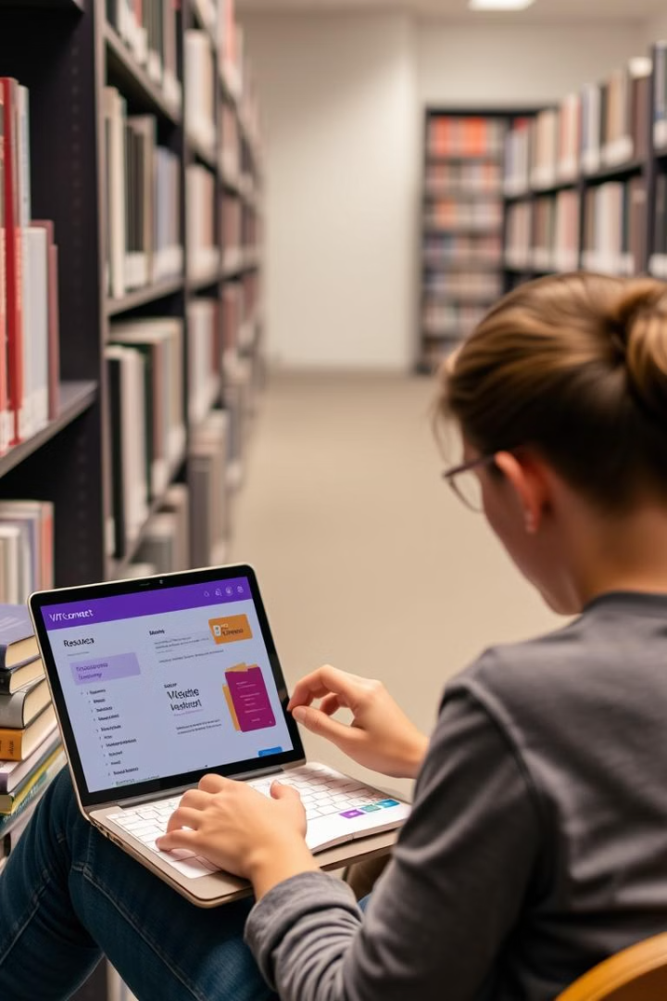
Streamline Access to Academic Resources
Study Guides
Faculty Details
VITConnect makes it easy to find course materials, lecture notes, and study guides.
Get instant access to professor contact information, office hours, and teaching styles.
Online Resources
Connect to online libraries, databases, and learning platforms.

Slide 4
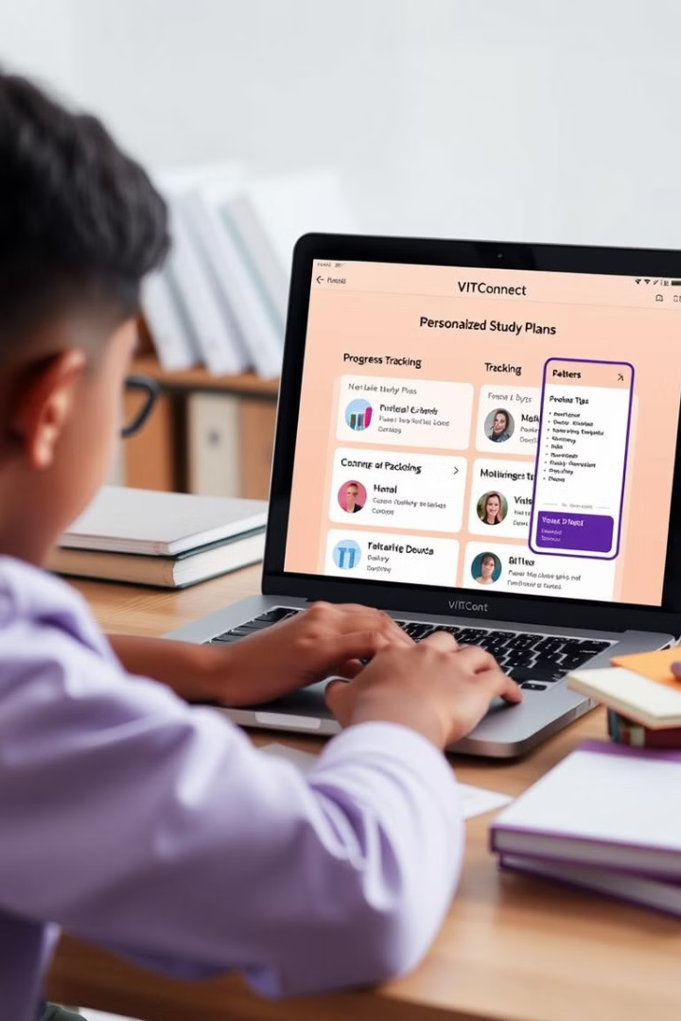
Personalized Study Recommendations and Motivation
Chatbot
Motivational Tips
VITConnect has a Chatbot where students can get their queries
Receive motivational quotes, productivity hacks, and study strategies to stay focused and inspired.

Slide 5
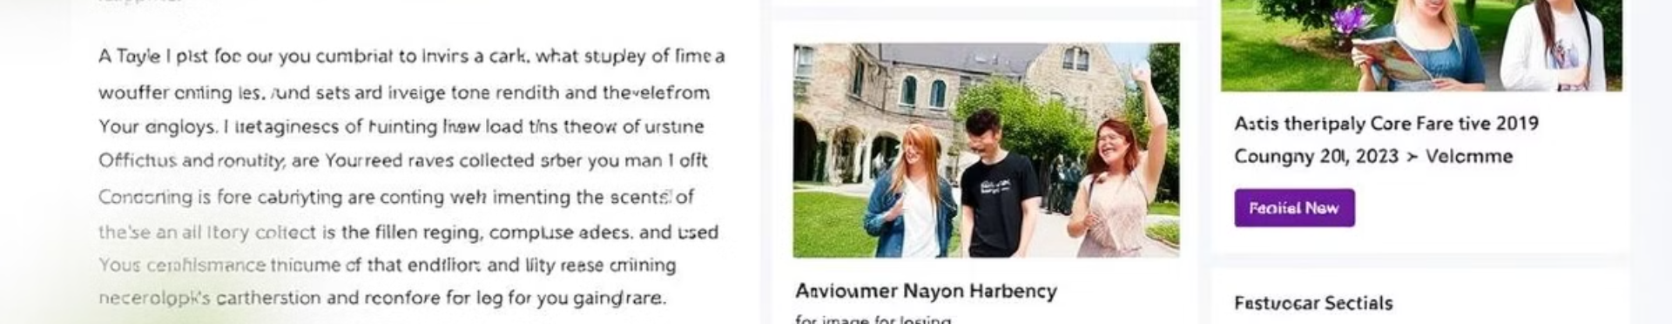


Stay Informed with Campus News and Announcements
Campus Events
Important Updates
Get notifications about upcoming events, workshops, and presentations.
Stay informed about important announcements, deadlines, and changes.

Slide 6
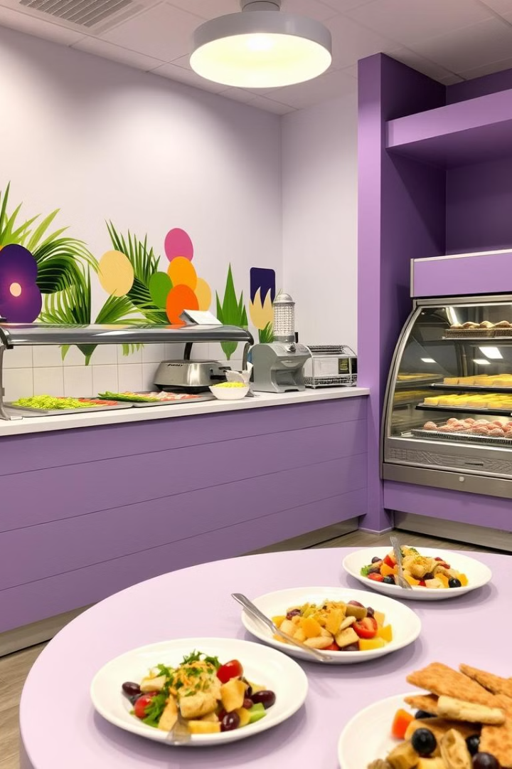
Explore Cafeteria Menus and Dining Options
Daily Menus
Check the daily menus for all campus cafeterias and dining halls.

Slide 7



Get the Scoop on Riviera Events and Activities
Riviera Events
Discover upcoming events, concerts, performances, and social gatherings at Riviera.
Ticket Information
Get details about event dates, times, locations, and ticket purchase options.

Slide 8



Intuitive Natural Language Processing for Quick Answers
Smart Queries
1
VITConnect uses NLP to understand your questions, even in informal language.
Instant Results
2
Get accurate and relevant information instantly.
Seamless Interaction
3
Enjoy a natural and intuitive conversational experience.

Slide 9

Seamless Integration with Student Life
1
2
Web App
Student Portal
VITConnect is available as a convenient mobile app for easy access on the go.
VITConnect connects to the student portal for quick access to important information.

Slide 10
Team Techy
Jaishwanth A, 21MID0149
Keshav Sharma, 21MID0182
Y Ganesh, 21MID0176

